Slide 1

A Foundational Look at the Top Five Productivity Agents

Slide 2


1. Coze
The Accessible Entry Point
•
Overview: Zero-code platform enabling users to quickly build intelligent AI agents without programming; a visual gateway for multi-plugin agents.
•
Strengths: Visual drag-and-drop workflow builder, built-in prompt engineering, Skills Marketplace, and "Agent Plan" for executing complex, long-term goals.
•
Weaknesses: High abstraction offers less fine-grained control for highly complex, code-heavy architecture compared to developer-first platforms.
•
Ease of Implementation: Very High. Utilizes an intuitive no-code/low-code interface.
•
Companies Adopted: Built by ByteDance. Adopted across diverse sectors for tasks ranging from legal research to video content creation.

Slide 3
2. Lindy.ai
The Conversational AI Employee
•
Overview: The benchmark for a "magic box" executive assistant that abstracts complexity away to effortlessly manage calendars, emails, and to-dos.
•
Strengths: Offers a highly conversational setup acting as a proactive personal AI assistant for immediate inbox and meeting management.
•
Weaknesses: Operates entirely as a "black box" that hides underlying architecture (like RAG databases), making it harder to visually demonstrate core orchestration.
•
Ease of Implementation: Extremely High. Consumer-friendly conversational setup requiring zero architectural planning.
•
Companies Adopted: Heavily utilized by solopreneurs, founders, and agile sales teams seeking instant personal productivity automation.

Slide 4
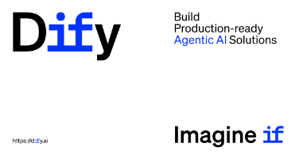
3. Dify
The Infrastructure Visualizer
•
Overview: Open-source application platform acting as a visual IDE for building AI apps, explicitly showing how the underlying agent architecture is built.
•
Strengths: Node-based "Dify Workflow", robust RAG engine accessing proprietary data, and support for running custom Python/JS within nodes.
•
Weaknesses: Steeper learning curve than conversational tools; requires foundational understanding of prompt templates, context management, and conditional logic.
•
Ease of Implementation: Medium. Requires architectural understanding but is visually guided via a drag-and-drop canvas.
•
Companies Adopted: Backed by an open-source community with 90K+ GitHub stars; used globally to build scalable LLM applications.

Slide 5
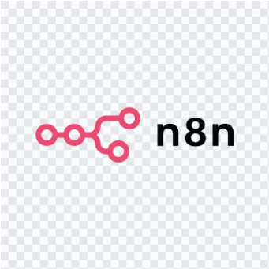
4. n8n
The Autonomous Orchestrator
•
Overview: An AI-native workflow automation platform that seamlessly blends the speed of no-code with the flexibility of full-code orchestration.
•
Strengths: Extreme flexibility allowing native JS, self-hosting for strict data privacy (HIPAA, GDPR), and native LLM connectors for end-to-end pipelines.
•
Weaknesses: Can be technically daunting for non-technical professionals; caters heavily to hybrid teams comfortable with custom code and APIs.
•
Ease of Implementation: Low to Medium. Requires logical workflow mapping, custom scripting, and a firm grasp of API operations.
•
Companies Adopted: Highly adopted by tech-forward startups, enterprise IT professionals, and hybrid teams blending dev and ops skillsets.

Slide 6

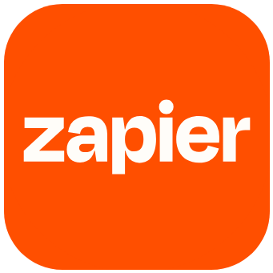
5. Zapier AI & MCP
The Legacy Bridge
•
Overview: Utilizes Model Context Protocol (MCP) as a secure gateway to Zapier's extensive library, letting AI act on your behalf directly from chat.
•
Strengths: Unparalleled market penetration (9,000+ app connections), SOC 2 compliance, and fine-grained action controls for strict administration.
•
Weaknesses: Costs two Zapier tasks per tool call executed, which can drain quotas quickly if used for autonomous background operations.
•
Ease of Implementation: High. Integrates directly with tools like Claude and ChatGPT, requiring no technical skills to set up the connection.
•
Companies Adopted: Used by teams needing to securely connect custom AI solutions to existing enterprise applications like Salesforce, Slack, or Outlook.

